Slide 1
GROUP NHN
FACTORY METHOD
FACTORY METHOD

Slide 2



Transportation
+ Transportation()
+ ~Transportation()
+ <<virtual>> Exist()
Car
Plane
Boat
+ Car()
+ ~Car()
+ <<virtual>> Exist()
+ Plane()
+ ~Plane()
+ <<virtual>> Exist()
+ Boat()
+ ~Boat()
+ <<virtual>> Exist()

Slide 3




without Factory Method
Whenever we need to instantiate an object, we use the new operator as usual:
class Transportation{…};
class Car: public Transportation{…};
class Plane: public Transportation{…};
class Boat: public Transportation{…};
And:
Transportation *pC=new Car;
Transportation *pP=new Plane;
Transportation *pB=new Boat;

Slide 4
Difficulty of the above way
The issue here is the actual Car type name appearing in the invocation of the new operator.
So, if you want to create an object of the type Plane, you have to go to the actual statement and replace Car with Plane. You cannot make the new operator act more dynamically: You must pass it a type, and that type must be exactly known at compile time.
Difficult to manage initialize the object.

Slide 5


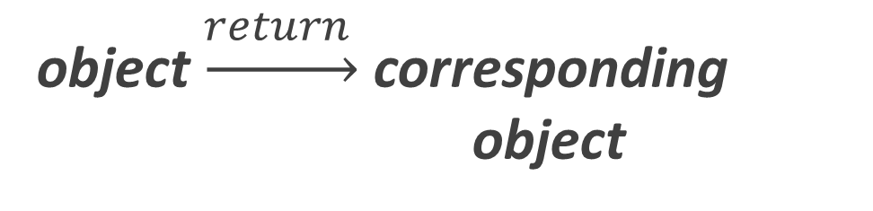
Difficulty of the above way
object
that can handle the initialization of these objects
object $\underset{→}{return }$ corresponding object
Factory object

Slide 6

Factory Method [ OverView]
Factory method is a Creational design pattern, i.e., related to object creation. In Factory pattern, we create object without exposing the creation logic to client and the client use the same common interface to create new type of object.
The idea is to use a static member-function (static factory method) which creates & returns instances, hiding the details of class modules from user.

Slide 7




above problem with Factory Method
Step 1: Create enum to save group of requests
Step 2: Build Factory
Step 3: Using Factory

Slide 8
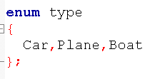

Slide 9
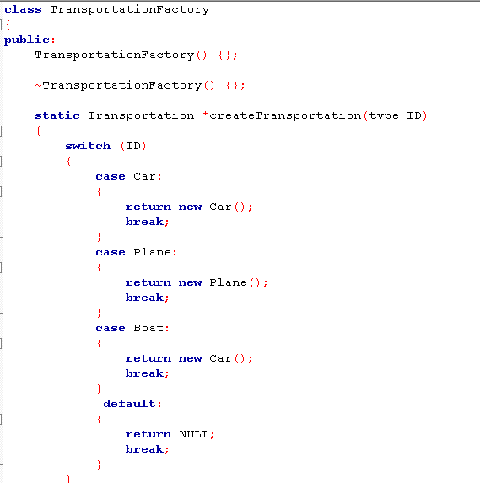

Slide 10
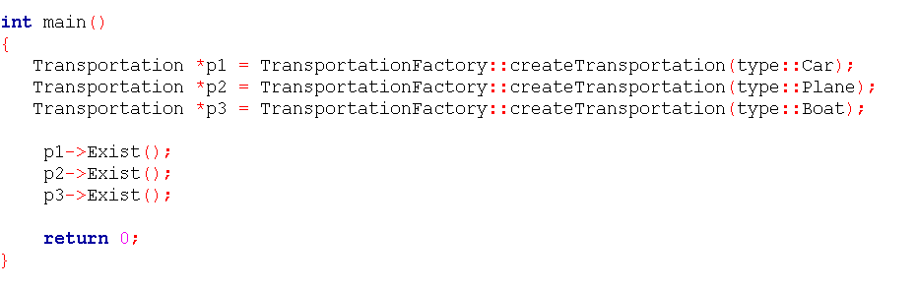
➢ Therefore, every time a new Transportation class is created, we add it to the Factory to manage initialization more easily.

Slide 11

Other problems solved with Factory Method
‘Drawing’ system, depending on user’s input, different pictures like square, rectangle, circle can be drawn. Here we can use factory method to create instances depending on user’s input.
If a Restaurant serves Veg food, Non-Veg food, and Italian food.
→ Treat VegFood, NonVegFood, and ItalianFood as three classes whose superclass is Food.
→ If a customer asks "Veg" then Factory method would return the "VegFood" class.

Slide 12
Advantages and Disadvantages
* Makes code more difficult to read as all of your code is behind an abstraction that may in turn hide abstractions.
* Reduced readability due to increased abstraction.
* Applicable only for families of classes.
ADVANTAGE
DISADVANTAGE
Allows you to hide implementation of an application seam (the core interfaces that make up your application).
Allows you to easily test the seam of an application (that is to mock/stub) certain parts of your application so you can build and test the other parts
Allows you to change the design of your application more readily, this is known as loose coupling.
It makes the application more customizable.
Makes code more difficult to read as all of your code is behind an abstraction that may in turn hide abstractions.
Reduced readability due to increased abstraction.
Applicable only for families of classes.

Slide 13
@REFERENCE:
http://uttakarshtikku.blogspot.com
https://www.quora.com/
https://www.geeksforgeeks.org/
https://www.stdio.vn/

Slide 14


THANKS FOR WATCHING

